Slide 1
Army Quantum Technology Challenge 2022 Sub-theme 2: Identifying Threats and Critical Information in Signals and Images
TEAM: SQC Algorithms
Casey R. Myers, Saleh Naghdi, Ian Thorvaldson, Sam Sutherland, Samuel K. Gorman, Ludwik Kranz & Michelle Y. Simmons
Silicon Quantum Computing Pty Ltd., UNSW Sydney, Kensington, NSW 2052, Australia
Adelaide, 10-August-2022

Slide 2

Dimensionality Reduction

Slide 3
What is Dimensionality Reduction?

Slide 4
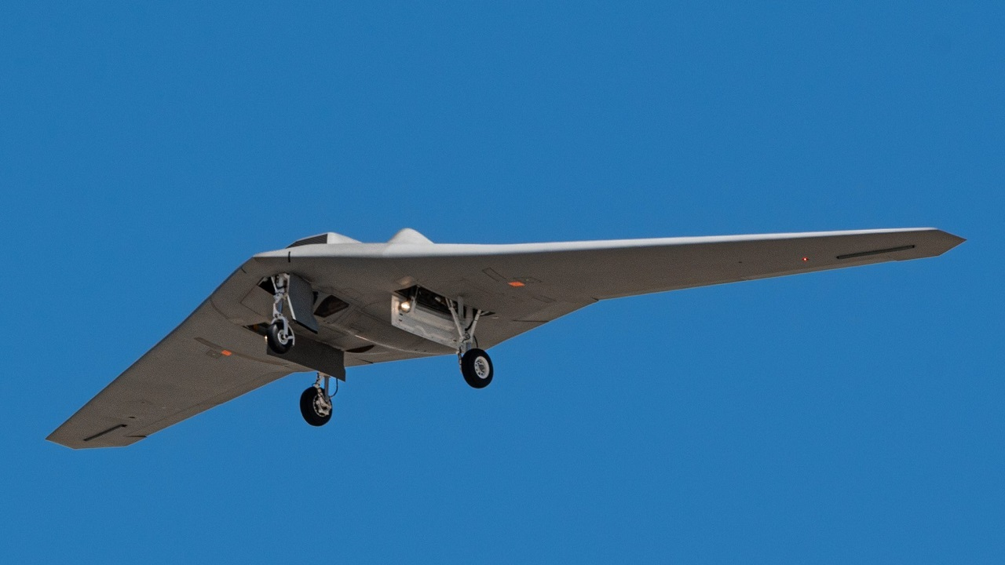
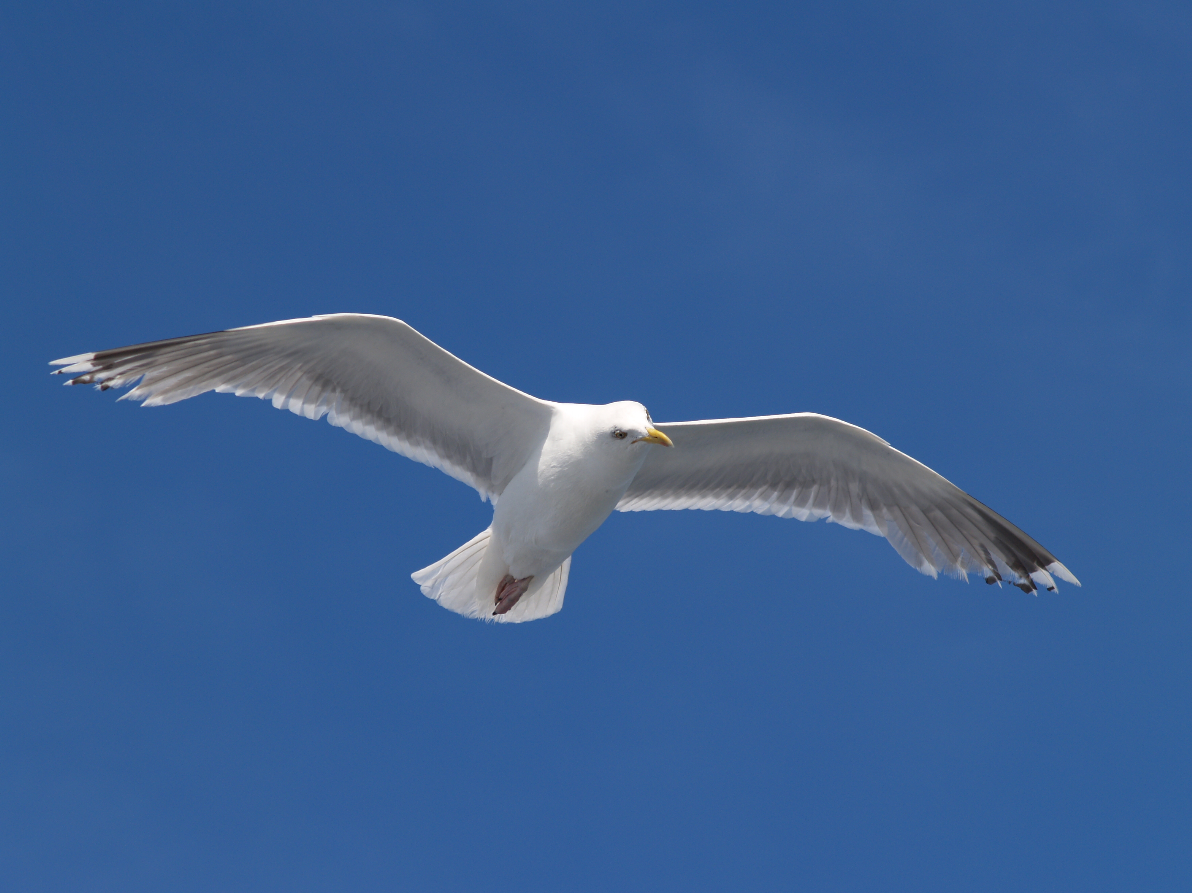
How do you tell a drone and seagull apart?

Slide 5
This drone has...
SHARP EDGES
WHEELS
BLINKING LIGHTS
NO BEAK
NO FEATHERS

Slide 6

Dense information
Summarising information
WHEELS
NO FEATHERS
SHARP EDGES
NO BEAK

Slide 7

Few features
BLINKING LIGHTS
WHEELS
NO FEATHERS
SHARP EDGES
NO BEAK

Slide 8

What about a computer?

Slide 9
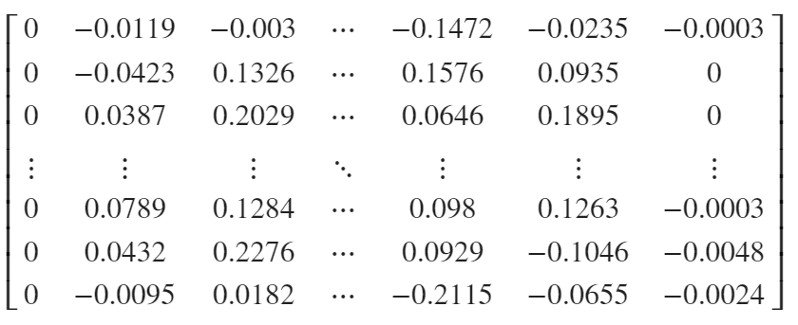
Highly dimensional data
Dimensionality reduction
Low dimensional features
0.15
0.8
7.48
0.234
5.684

Slide 10
Dimensionality reduction
Low dimensional features
0.15
0.8
0.234
5.684

Slide 11
Classical Dimensionality Reduction Algorithms

Slide 12
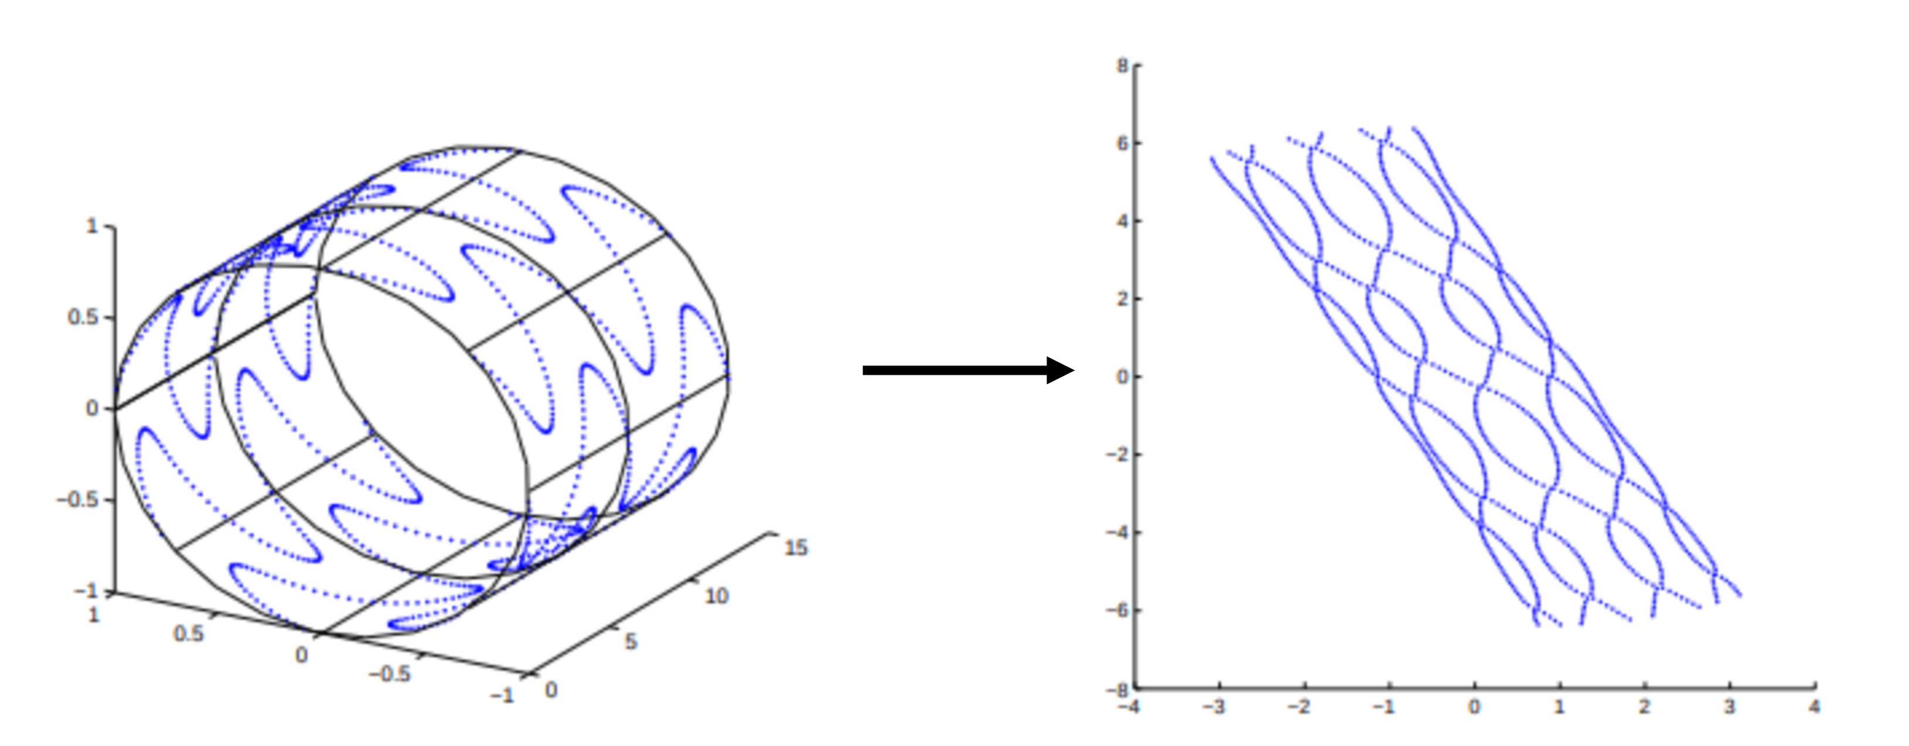
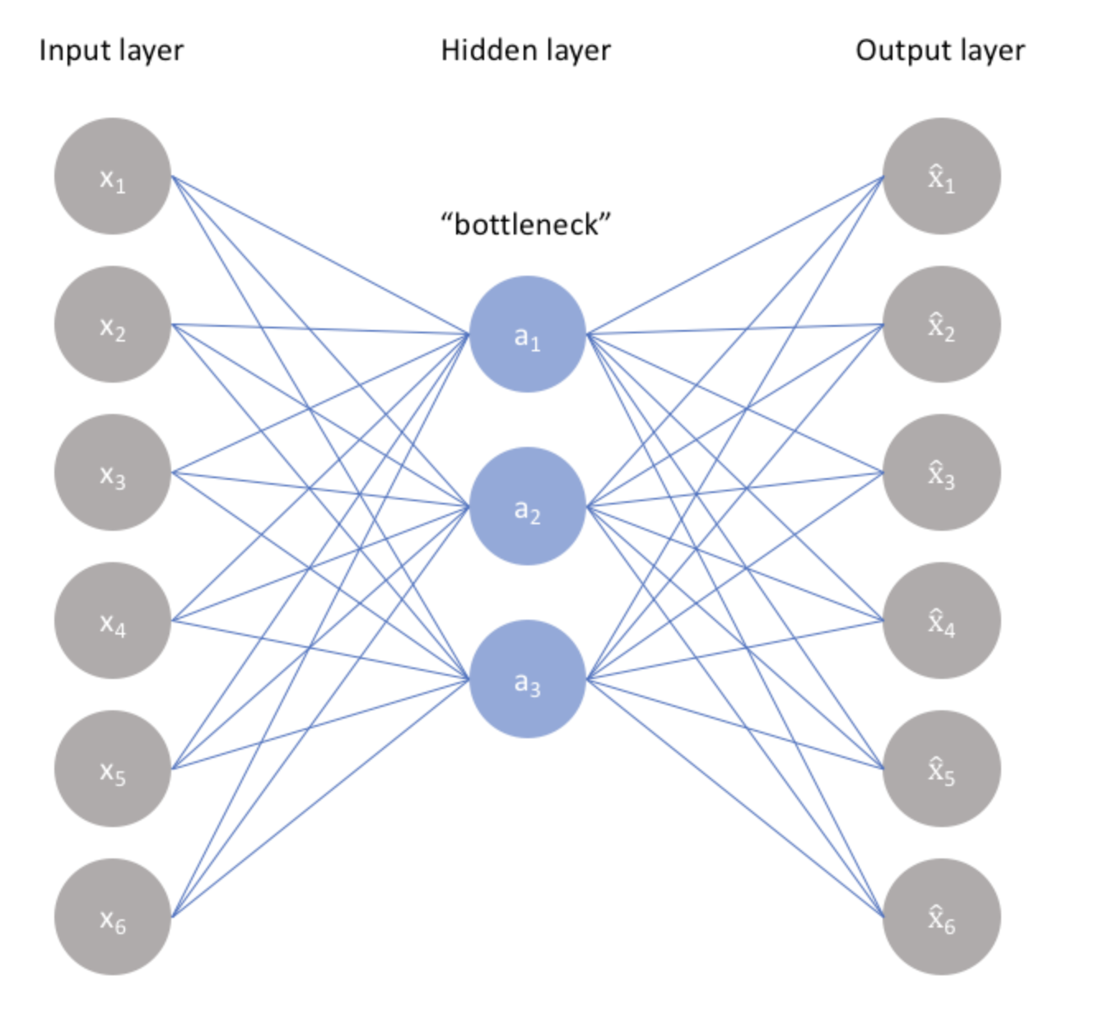
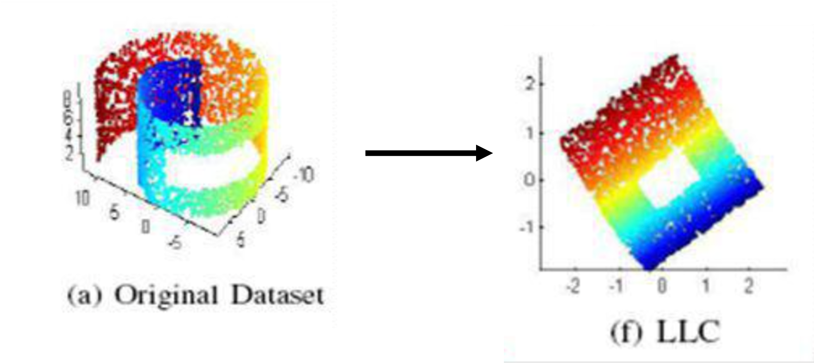
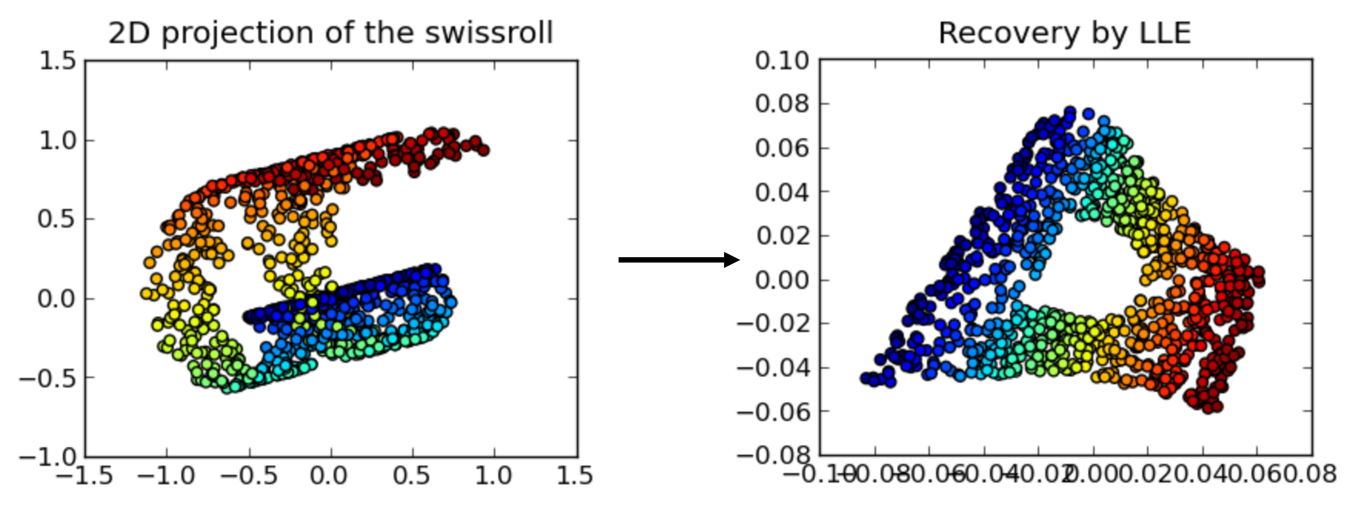
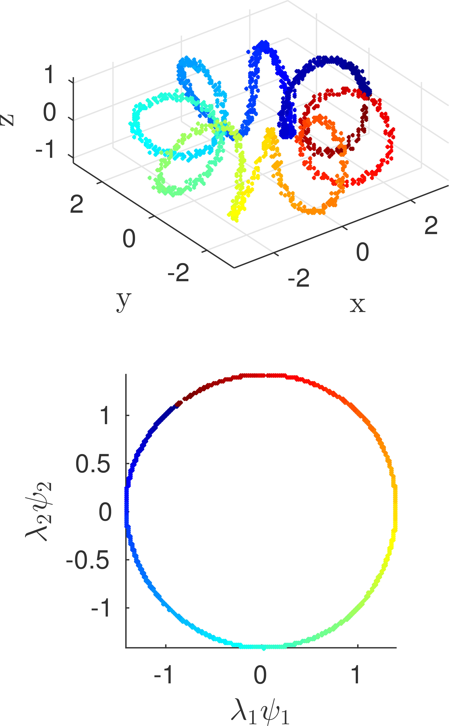
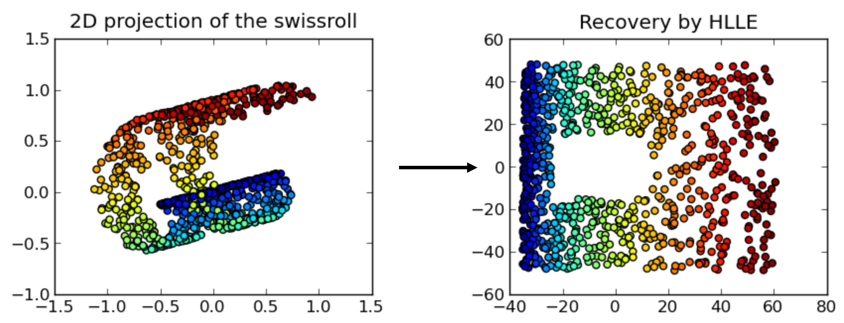
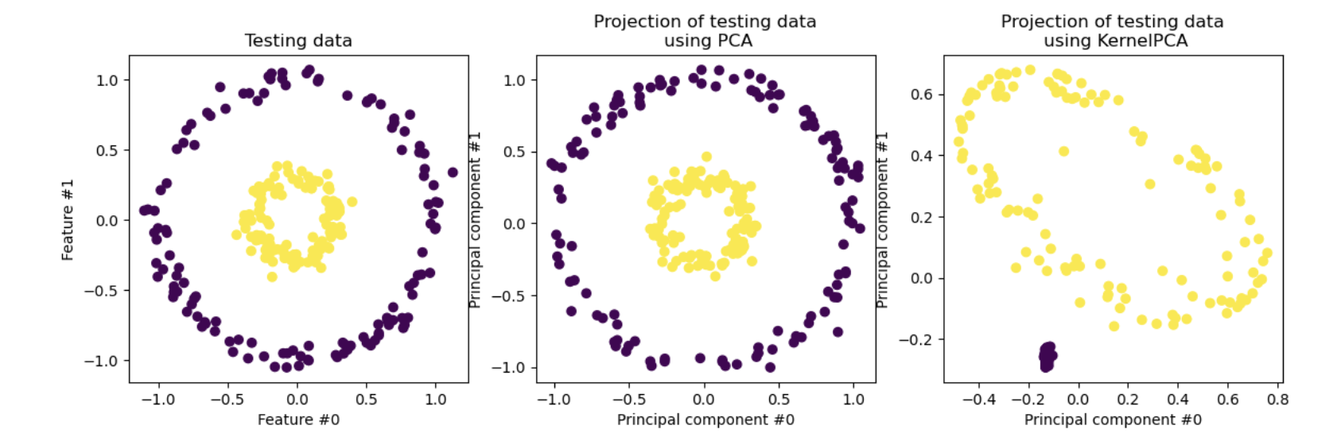
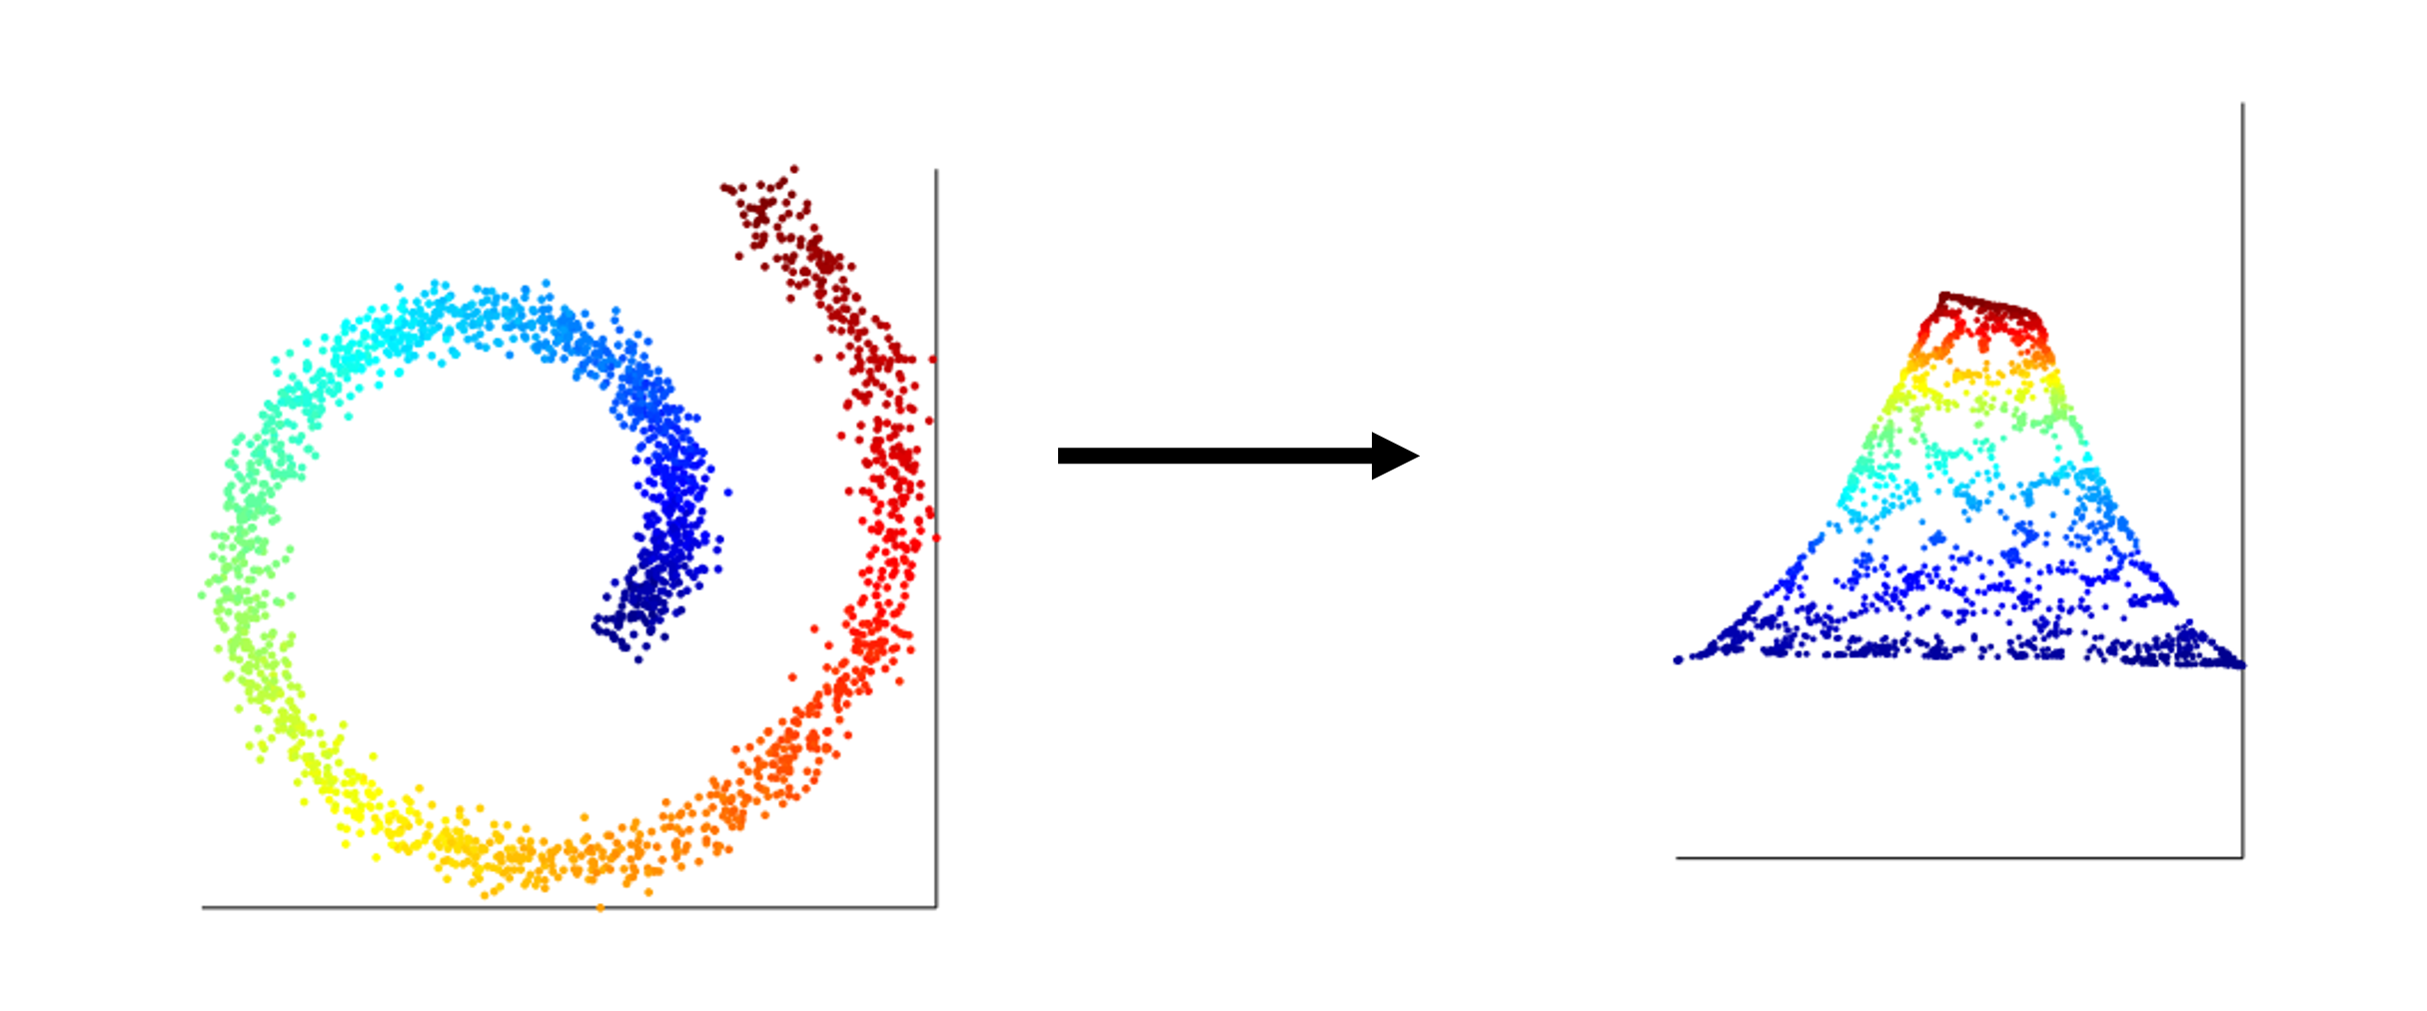
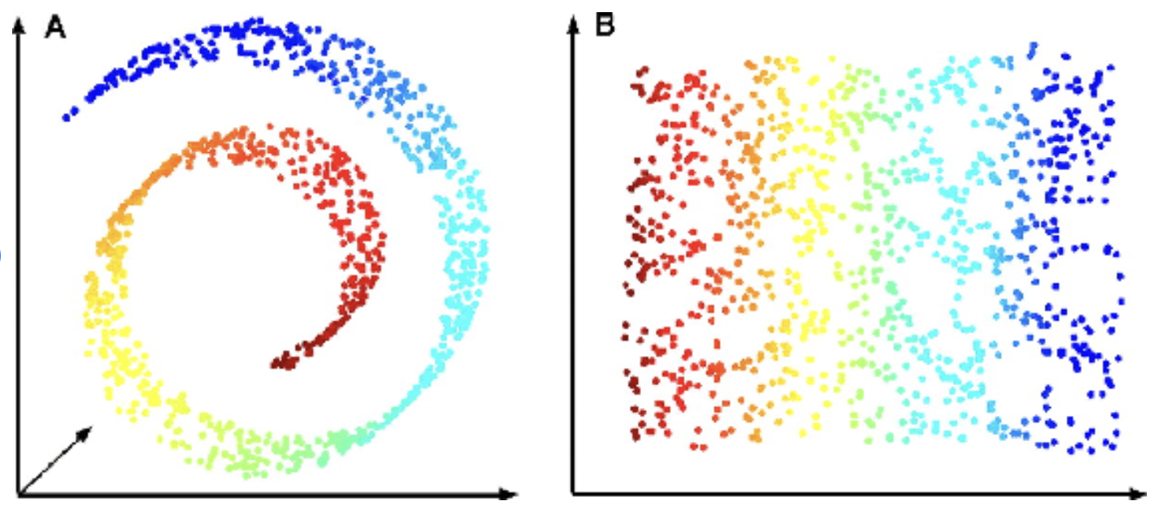
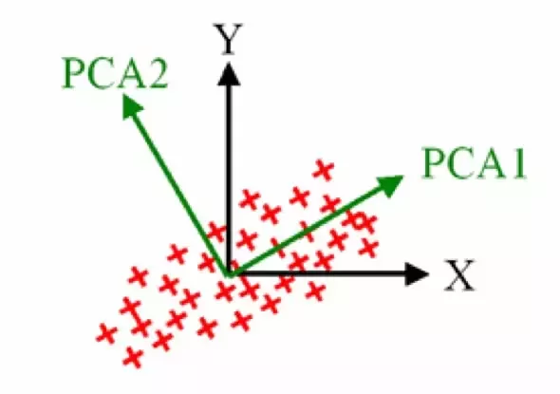
Dimensionality Reduction Algorithms
Convex
Non-convex
Full Spectral
Sparse Spectral

Slide 13
Classical Quantum Dimensionality Reduction Algorithms

Slide 14
History of Dimensionality Reduction
Amplitude Amplification (AA)
Kernel PCA
Discriminative Canonical Correlation Analysis
Grover’s Algorithm
Quantum Phase Estimation (QPE)
Linear Systems of Equations (HHL)
Slow Feature Analysis
Principal Component Analysis (PCA)
Matrix operations (Singular value transformation)
Matrix operations (matrix powers)
Diffusion Maps
Shor’s Algorithm
Quantum RAM (qRAM)
Isomap
1994
1995
1996
...
2008
2009
...
2013
2014
2015
2016
...
2019
2020
2021
2022
Fundamental Quantum Algorithms
Linear Discriminant Analysis
A-Optimal Projection
QPE sub-component
AA sub-component
Laplacian Eigenmap
Locally Linear Embedding
Locality Preserving Projection
HHL sub-component
Matrix arithmetic sub-component
Semi Non-negative Matrix Factorisation
Other sub-component

Slide 15
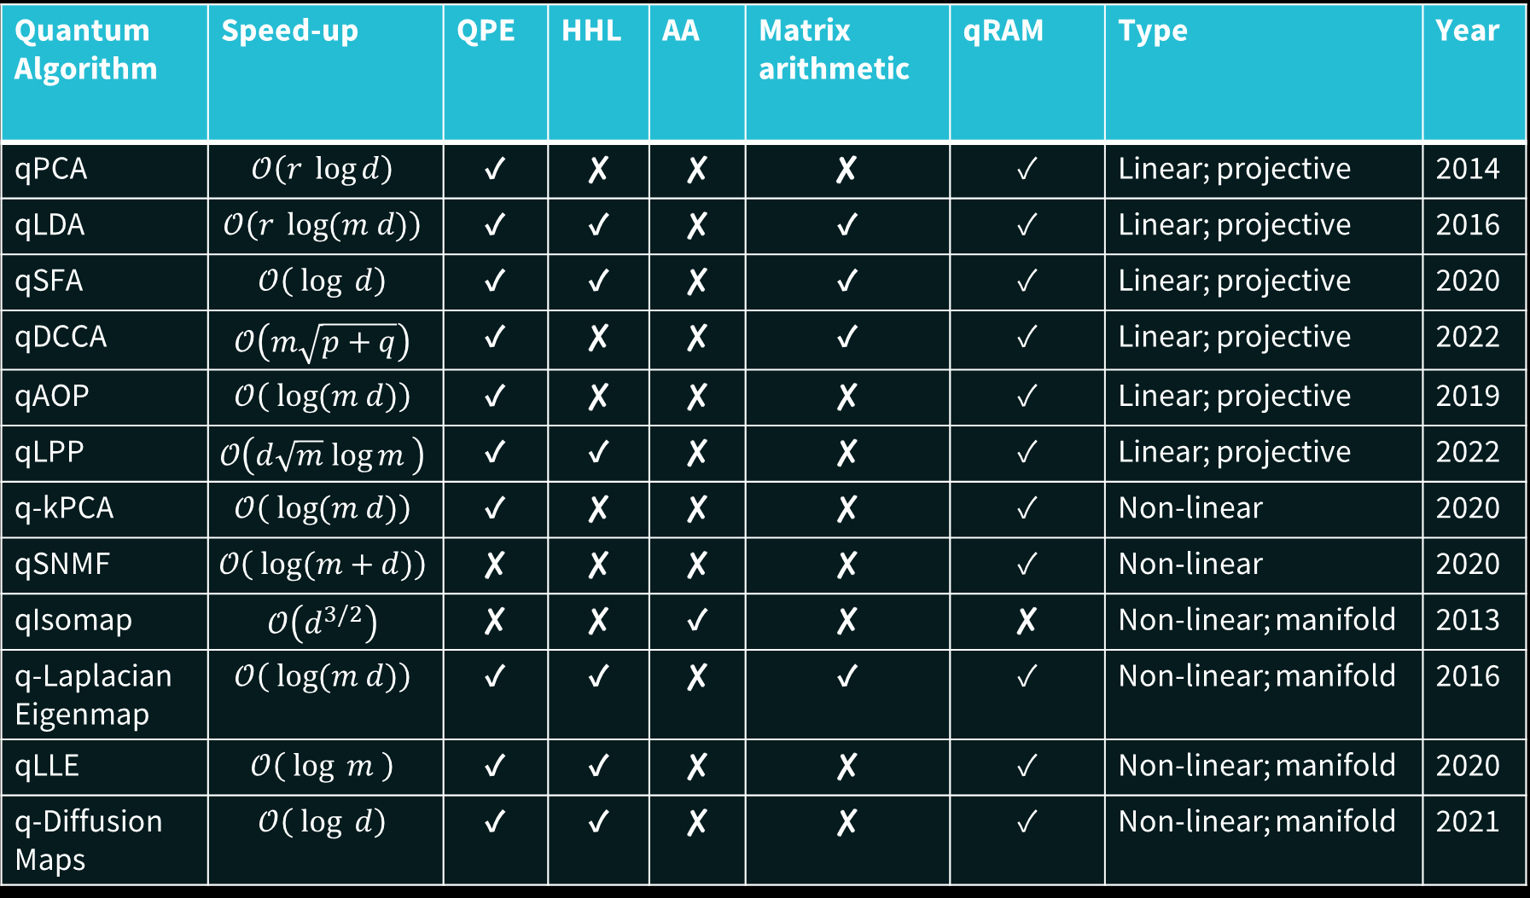
Quantum Algorithm | Speed-up | QPE | HHL | AA | Matrix arithmetic | qRAM | Type | Year
qPCA | $$𝒪\left(r \log{d}\right)$$ | ✓ | ✘ | ✘ | ✘ | ✓ | Linear; projective | 2014
qLDA | $$𝒪\left(r \log{(m d)}\right)$$ | ✓ | ✓ | ✘ | ✓ | ✓ | Linear; projective | 2016
qSFA | $$𝒪\left( \log{ d}\right)$$ | ✓ | ✓ | ✘ | ✓ | ✓ | Linear; projective | 2020
qDCCA | $$𝒪\left(m\sqrt{p+q}\right)$$ | ✓ | ✘ | ✘ | ✓ | ✓ | Linear; projective | 2022
qAOP | $$𝒪\left( \log{(m d)}\right)$$ | ✓ | ✘ | ✘ | ✘ | ✓ | Linear; projective | 2019
qLPP | $$𝒪\left(d\sqrt{m} log{m }\right)$$ | ✓ | ✓ | ✘ | ✘ | ✓ | Linear; projective | 2022
q-kPCA | $$𝒪\left( \log{(m d)}\right)$$ | ✓ | ✘ | ✘ | ✘ | ✓ | Non-linear | 2020
qSNMF | $$𝒪\left( \log{(m+d)}\right)$$ | ✘ | ✘ | ✘ | ✘ | ✓ | Non-linear | 2020
qIsomap | $$𝒪\left(d^{3/2}\right)$$ | ✘ | ✘ | ✓ | ✘ | ✘ | Non-linear; manifold | 2013
q-Laplacian Eigenmap | $$𝒪\left( \log{(m d)}\right)$$ | ✓ | ✓ | ✘ | ✓ | ✓ | Non-linear; manifold | 2016
qLLE | $$𝒪\left( \log{m }\right)$$ | ✓ | ✓ | ✘ | ✘ | ✓ | Non-linear; manifold | 2020
q-Diffusion Maps | $$𝒪\left( \log{ d}\right)$$ | ✓ | ✓ | ✘ | ✘ | ✓ | Non-linear; manifold | 2021
Notes:
Table’s too confusing

Slide 16
Quantum Algorithm | Speed-up | QPE | HHL | AA | Matrix arithmetic | qRAM | Type | Year
qPCA | $$𝒪\left(r \log{d}\right)$$ | ✓ | ✘ | ✘ | ✘ | ✓ | Linear; projective | 2014
qLDA | $$𝒪\left(r \log{(m d)}\right)$$ | ✓ | ✓ | ✘ | ✓ | ✓ | Linear; projective | 2016
qSFA | $$𝒪\left( \log{ d}\right)$$ | ✓ | ✓ | ✘ | ✓ | ✓ | Linear; projective | 2020
qDCCA | $$𝒪\left(m\sqrt{p+q}\right)$$ | ✓ | ✘ | ✘ | ✓ | ✓ | Linear; projective | 2022
qAOP | $$𝒪\left( \log{(m d)}\right)$$ | ✓ | ✘ | ✘ | ✘ | ✓ | Linear; projective | 2019
qLPP | $$𝒪\left(d\sqrt{m} log{m }\right)$$ | ✓ | ✓ | ✘ | ✘ | ✓ | Linear; projective | 2022
q-kPCA | $$𝒪\left( \log{(m d)}\right)$$ | ✓ | ✘ | ✘ | ✘ | ✓ | Non-linear | 2020
qSNMF | $$𝒪\left( \log{(m+d)}\right)$$ | ✘ | ✘ | ✘ | ✘ | ✓ | Non-linear | 2020
qIsomap | $$𝒪\left(d^{3/2}\right)$$ | ✘ | ✘ | ✓ | ✘ | ✘ | Non-linear; manifold | 2013
q-Laplacian Eigenmap | $$𝒪\left( \log{(m d)}\right)$$ | ✓ | ✓ | ✘ | ✓ | ✓ | Non-linear; manifold | 2016
qLLE | $$𝒪\left( \log{m }\right)$$ | ✓ | ✓ | ✘ | ✘ | ✓ | Non-linear; manifold | 2020
q-Diffusion Maps | $$𝒪\left( \log{ d}\right)$$ | ✓ | ✓ | ✘ | ✘ | ✓ | Non-linear; manifold | 2021

Slide 17
A Crucial Dimensionality Reduction Subroutine: Quantum Phase Estimation (QPE)

Slide 18
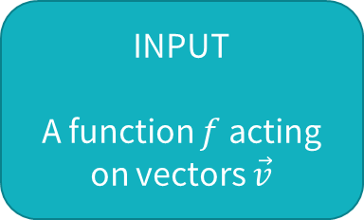


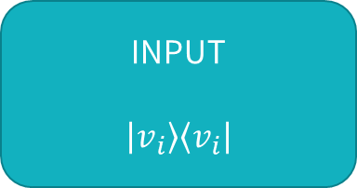

The Eigenvalue Problem
INPUT
A function $f$ acting on vectors $\vec{v}$
OUTPUT
all $λ_{i}$ and ${\vec{v}}_{i}$satisfying $f\left({\vec{v}}_{i}\right)=λ{\vec{v}}_{i}$
Eigenvalue: $λ_{i}$
Eigenvector: ${\vec{v}}_{i}$
Quantum Phase Estimation
INPUT
$$\left|v_{i}\right\rangle \left\langle v_{i}\right|$$
OUTPUT
$$\left|v_{i}\right\rangle \left\langle v_{i}\right|⊗\left|λ_{i}\right\rangle \left\langle λ_{i}\right|$$

Slide 19

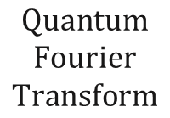

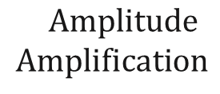
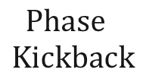

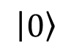

$$Phase$$
$$Kickback$$
$$Quantum$$
$$Fourier$$
$$Transform$$
$$\left|λ_{i}\right\rangle \left\langle λ_{i}\right|$$
$$\left|0\right\rangle$$
$$H$$
$$\left|v_{i}\right\rangle \left\langle v_{i}\right|$$
$$Amplitude$$
$$Amplification$$
$$\left|v_{i}\right\rangle \left\langle v_{i}\right|$$

Slide 20

Performance on Silicon Hardware?

Slide 21
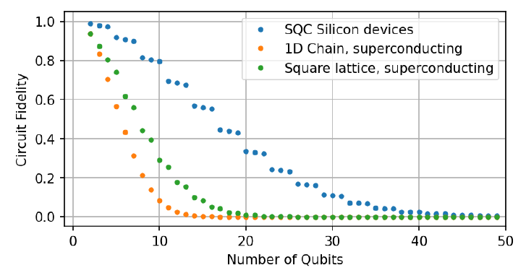
Estimated circuit fidelity for QPE using Silicon Hardware

Slide 22
An algorithm relying on QPE: quantum Principal Component Analysis (qPCA)

Slide 23
Classical Principal Component Analysis (PCA)

Slide 24
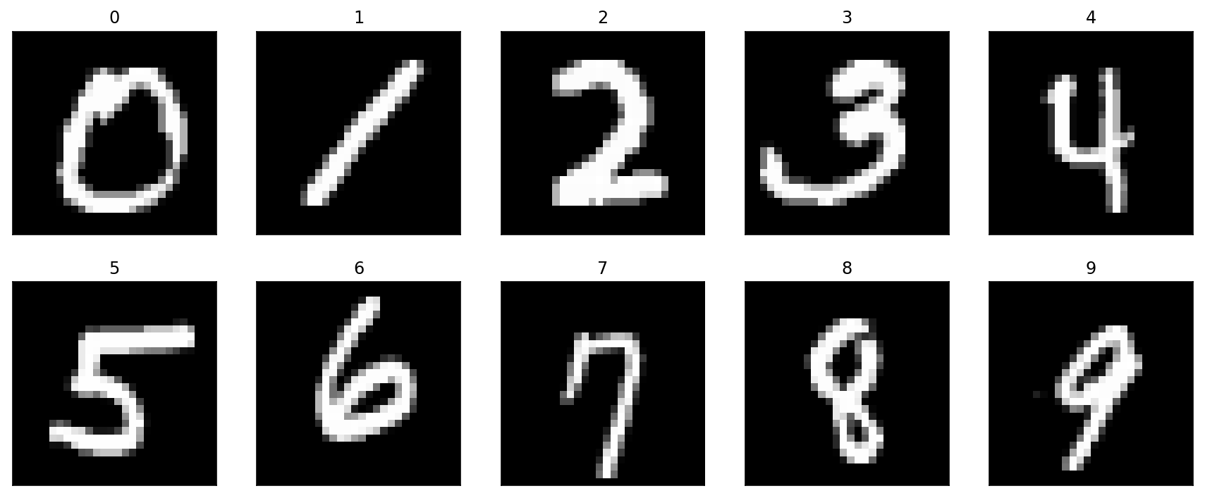

Slide 25
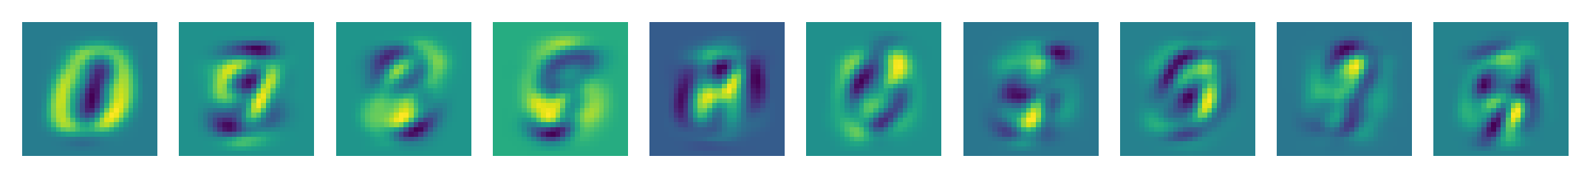
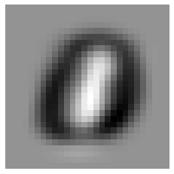
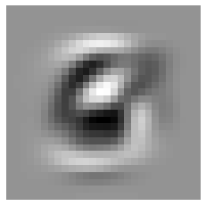
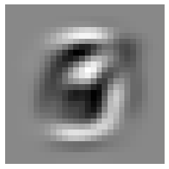
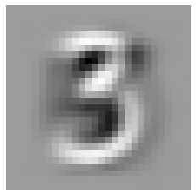
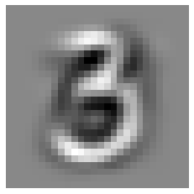
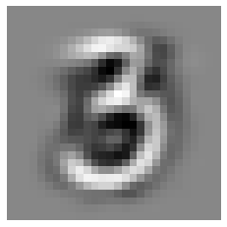
Classical Principal Component Analysis
Most important component
Least important component
Images constructed from
weighted sums of components
Cut off here
1 Component
10 Components
20 Components
30 Components
40 Components
50 Components

Slide 26
Classical Quantum Principal Component Analysis (qPCA)

Slide 27
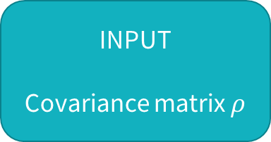

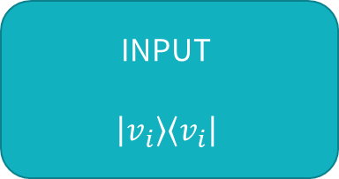

Quantum Phase Estimation
INPUT
$$\left|v_{i}\right\rangle \left\langle v_{i}\right|$$
OUTPUT
$$\left|v_{i}\right\rangle \left\langle v_{i}\right|⊗\left|λ_{i}\right\rangle \left\langle λ_{i}\right|$$
Quantum Principal Component Analysis
INPUT
Covariance matrix $ρ$
OUTPUT
$$\sum_{i}{λ_{i}\left|v_{i}\right\rangle \left\langle v_{i}\right|⊗\left|λ_{i}\right\rangle \left\langle λ_{i}\right|}$$

Slide 28
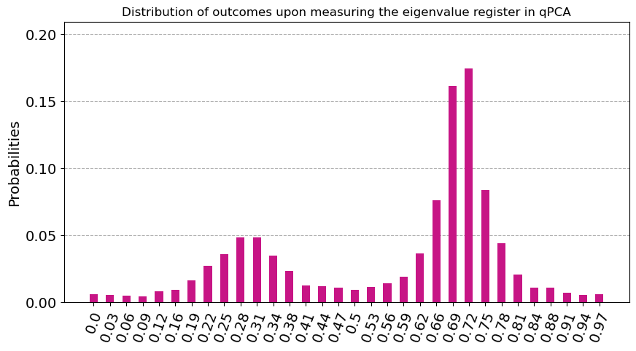

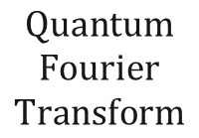

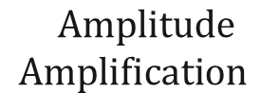




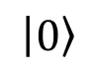


$$Phase$$
$$Kickback$$
$$Quantum$$
$$Fourier$$
$$Transform$$
$$\left|λ_{i}\right\rangle \left\langle λ_{i}\right|$$
$$\left|0\right\rangle$$
$$H$$
$$ρ$$
$$Amplitude$$
$$Amplification$$
$$λ_{i}\left|v_{i}\right\rangle \left\langle v_{i}\right|$$
$$ρ=\left(\begin{matrix}0.5 & 0.48 \\ 0.48 & 0.5\end{matrix}\right)$$
0.72$\left|v_{1}\right\rangle \left\langle v_{1}\right|+\text{0.}29\left|v_{2}\right\rangle \left\langle v_{2}\right|$
Eigenvectors with larger eigenvalues are measured more often
$$⇒$$
The most important principal components are measured more often

Slide 29
Performance on Silicon Hardware?

Slide 30
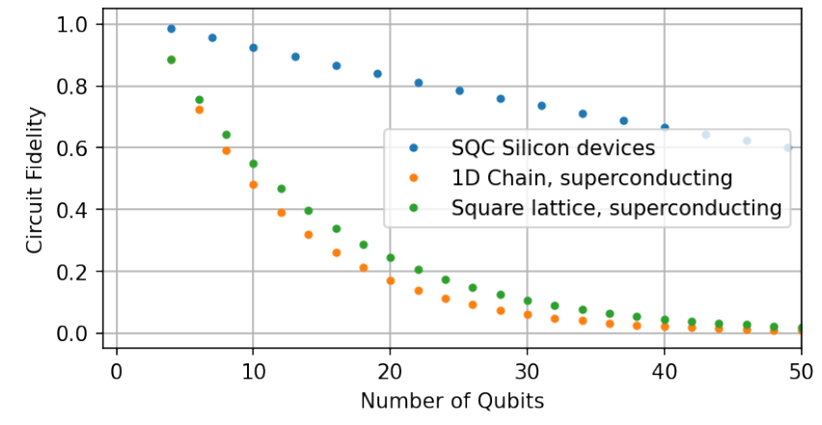
Estimated circuit fidelity for QPE

Slide 31
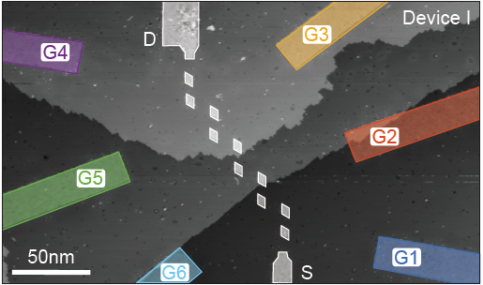
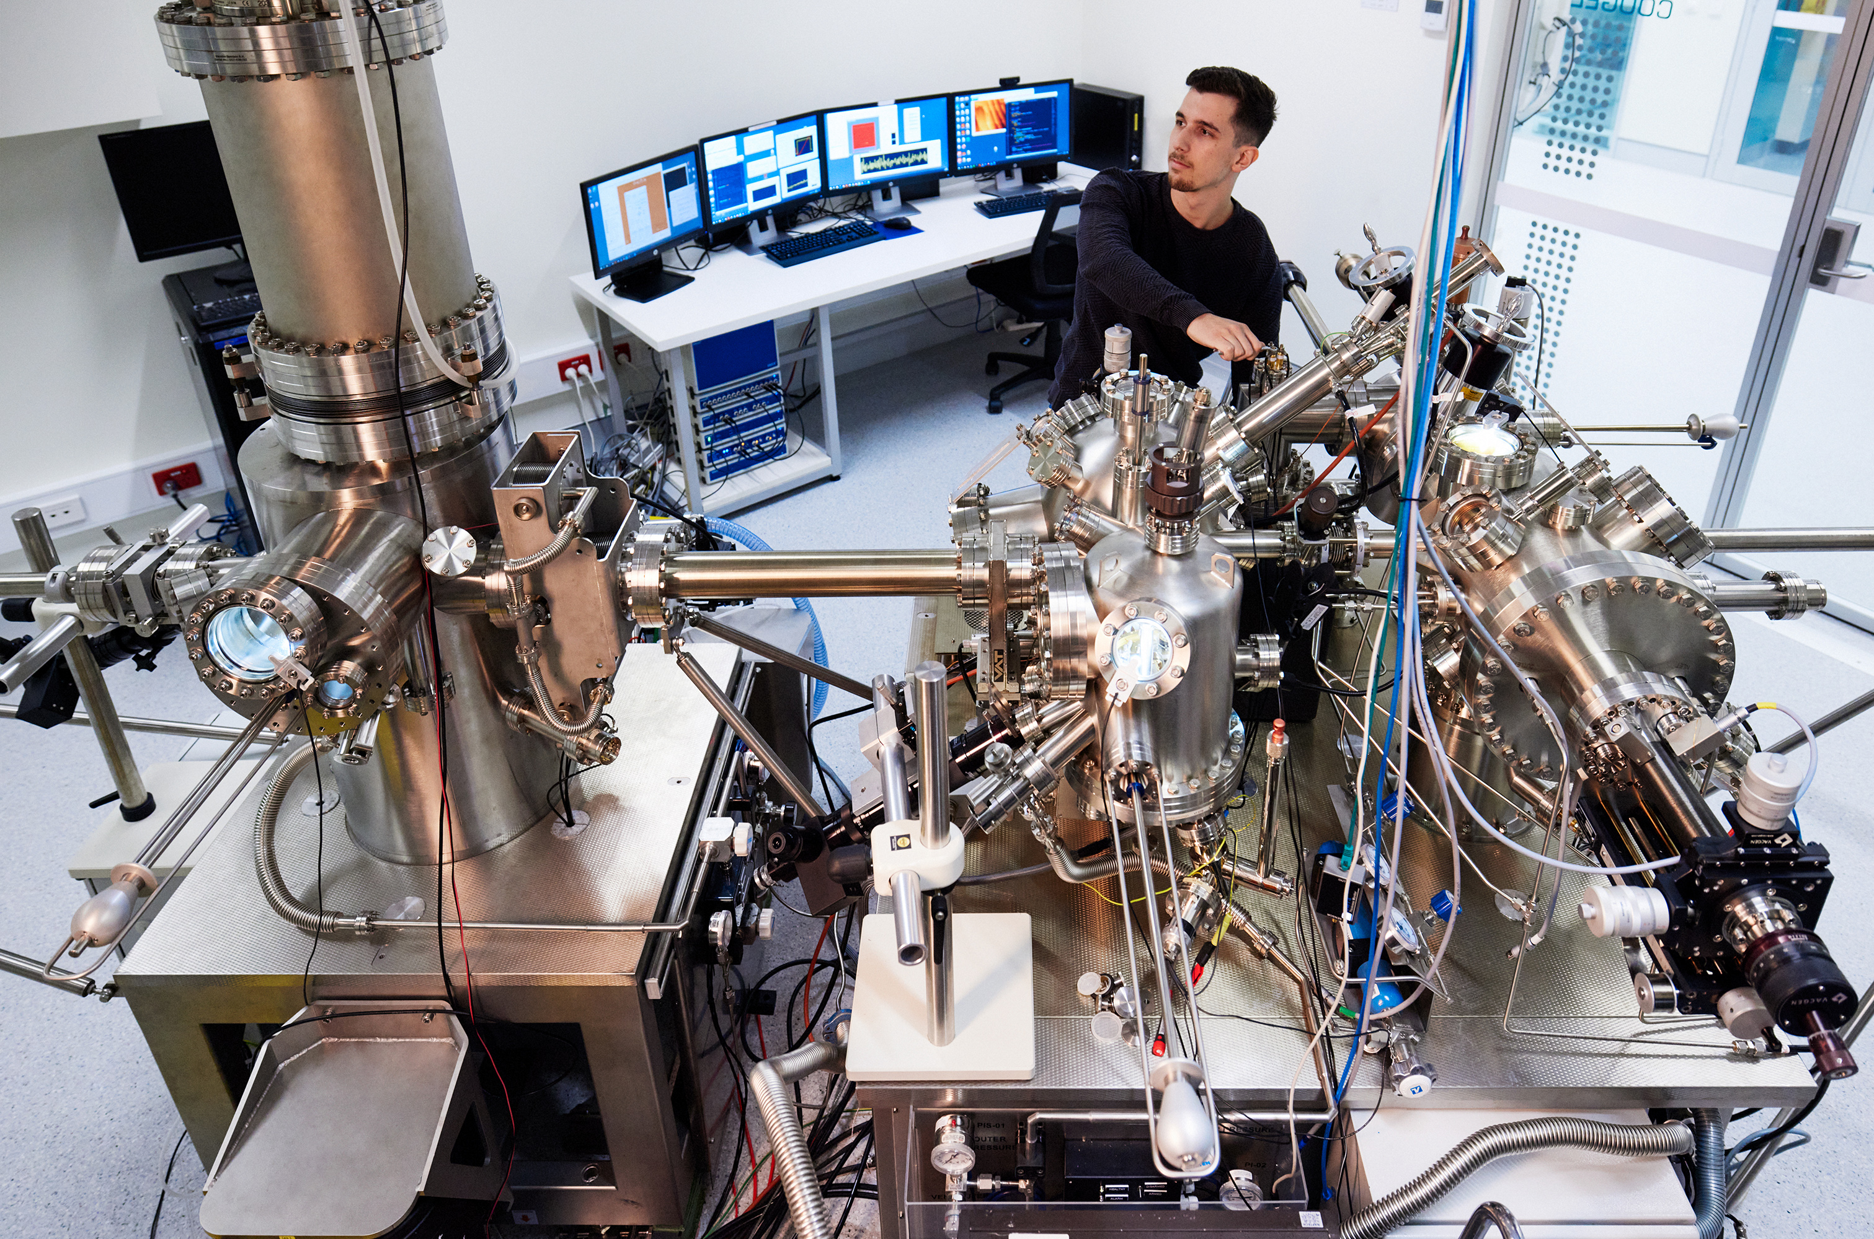
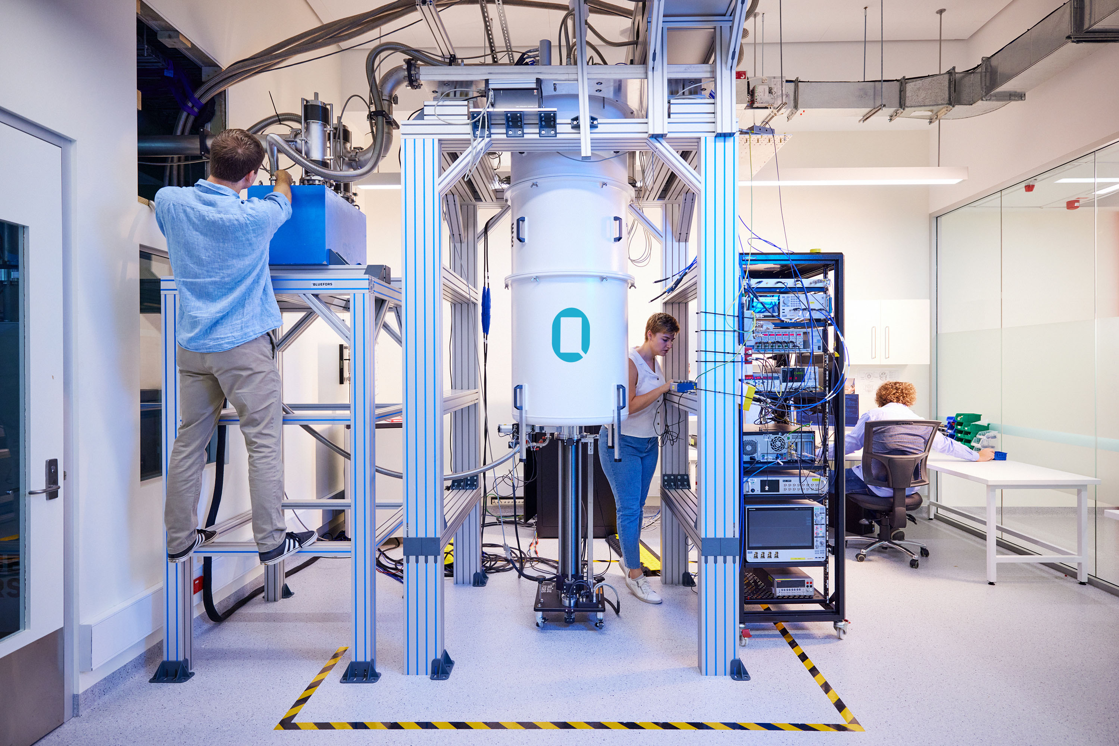
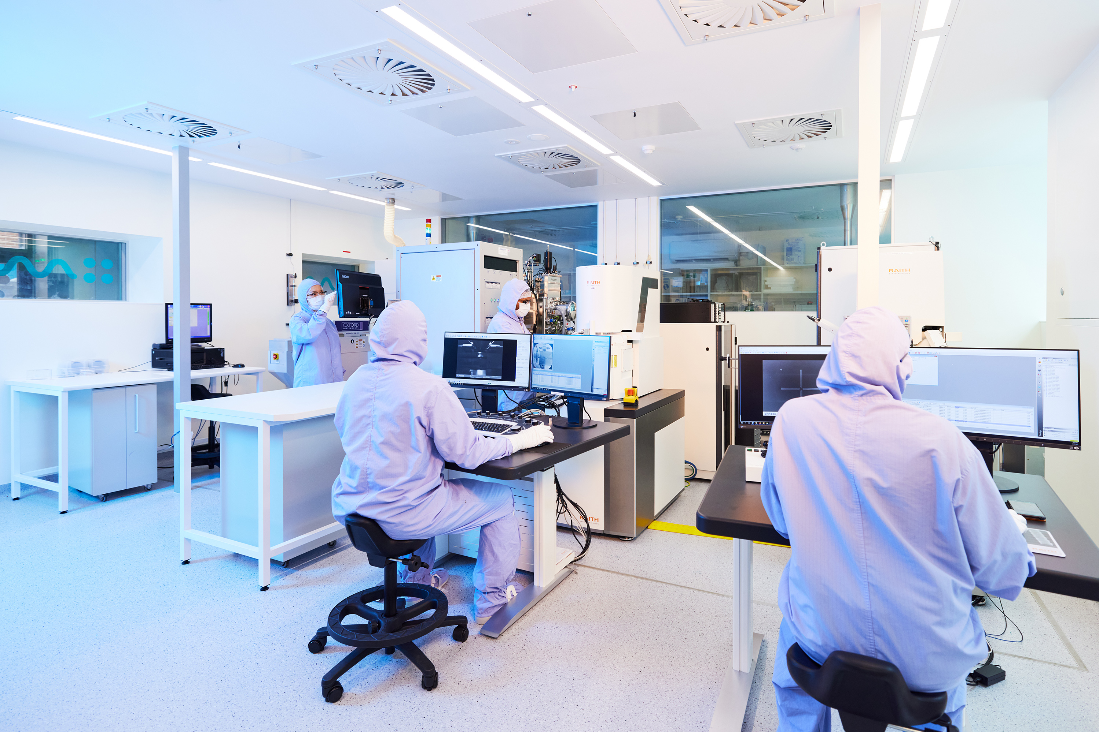
SQC is a full stack company
Application-specific Device Design
Atomic-Scale Fabrication
1-2 week cycle
Cryogenic Measurements
Cleanroom Processing
Notes:
What’s also unique about SQC is the fact that we are a full-stack company, and all of our manufacturing is done in-house at UNSW where we have state of the art STMs and cleanrooms. This means that we can design a device, fabricate it with the STM, package the silicon chip in the cleanroom, and measure the device at cryogenic temperatures. Since electrons are naturally confined to donors at low temperatures, this means that our devices require very little tuning and we start getting results after just few days. So our overall prototyping cycle is only around 1-2 weeks, which is much shorter comparing to other QC platforms.

Slide 32
Thank you

